Slide 1
GPT Pretraining Stage Implementation
Sparsh Celly

Slide 2
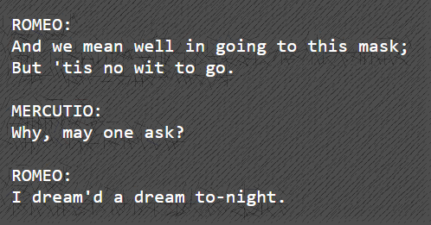
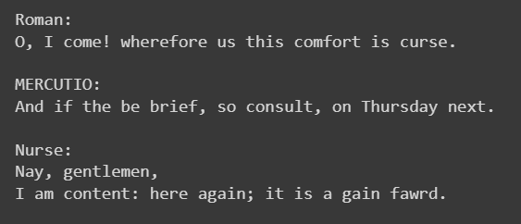
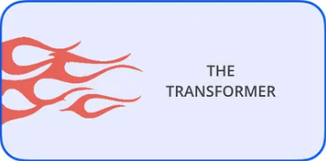
Problem Statement
To create a generalized Large Language Model which generates text resembling the syntactic and semantic pattern of the text corpus it is trained on
Existing text
New unique text

Slide 3
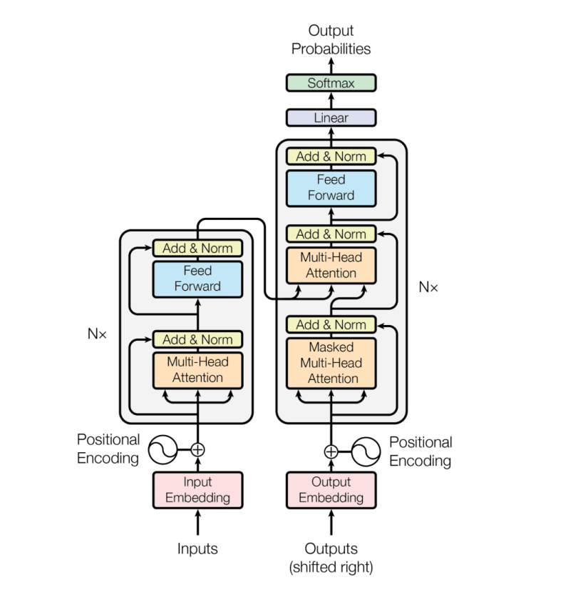
OpenAI’s GPT Architecture
Used for sequence to sequence translation/analysis
Encoder + Decoder architecture
Cross Attention + Self Attention

Slide 4
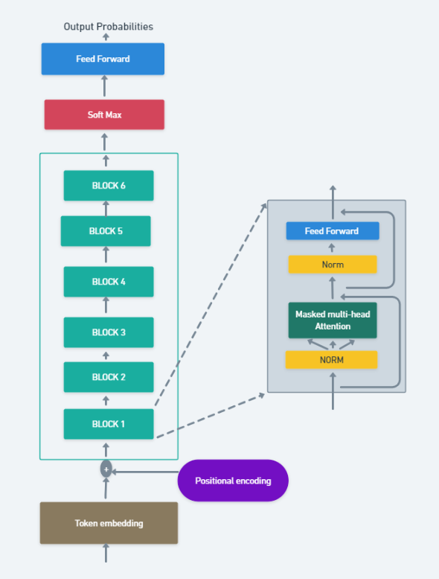
Our GPT Architecture
6 layer deep Decoder only architecture
Self-Attention
Res-Net (CNN)
Initialized weights within a standard deviation (BERT)
Used PreNorm (Llama)
Introduced Dropout to tackle overfitting

Slide 5
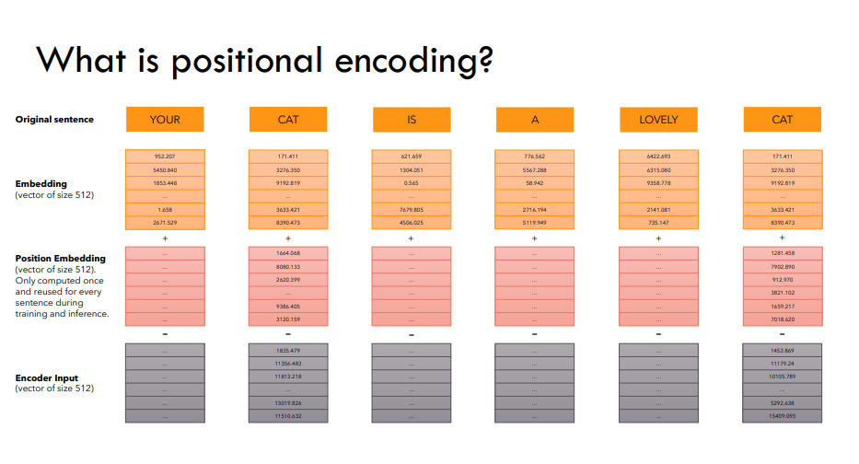
Working
Token + Positional Embedding

Slide 6
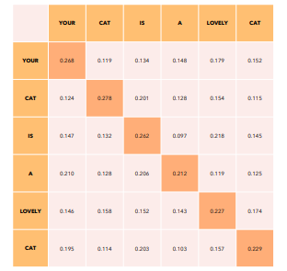
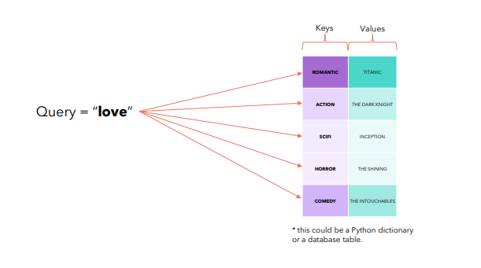
Working
Initial random embedding table
Intuition of Q,K,V matrices

Slide 7
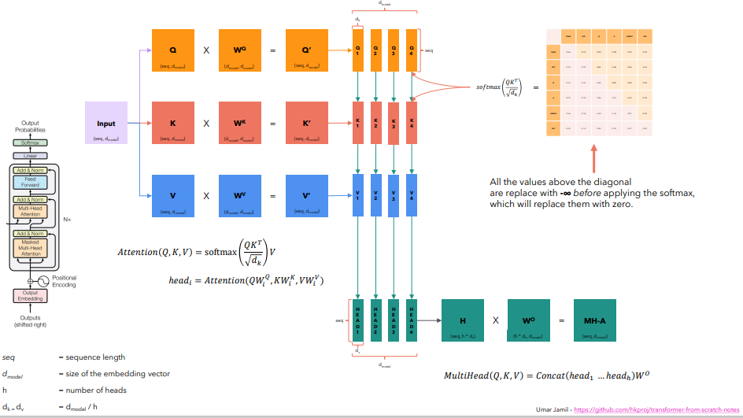
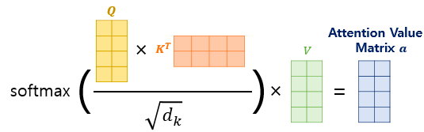
Working
Muti-Head Attention

Slide 8
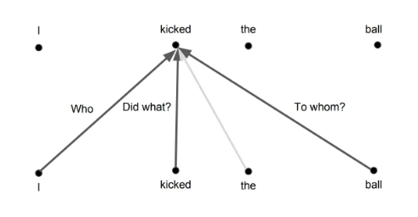
Working
What Logits table represents
→ Passed into generator function to generate text
Final Logits table ready

Slide 9
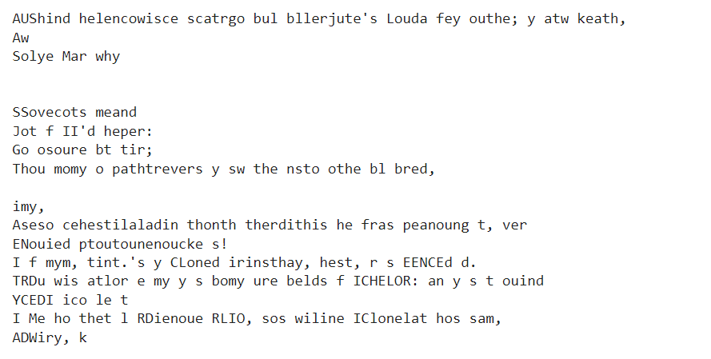
Attempts
Basic Bi-Gram model
50,000 epochs
Loss: 2.530

Slide 10
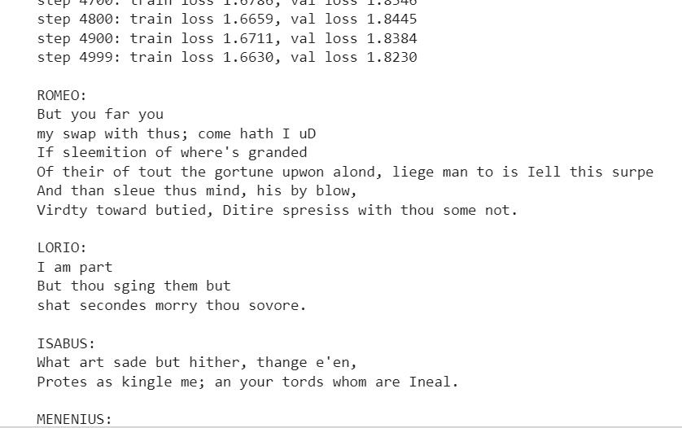
Attempts
2. Self-Attention GPT Model
0.20 M parameters
5000 epochs
Loss: 1.8239

Slide 11
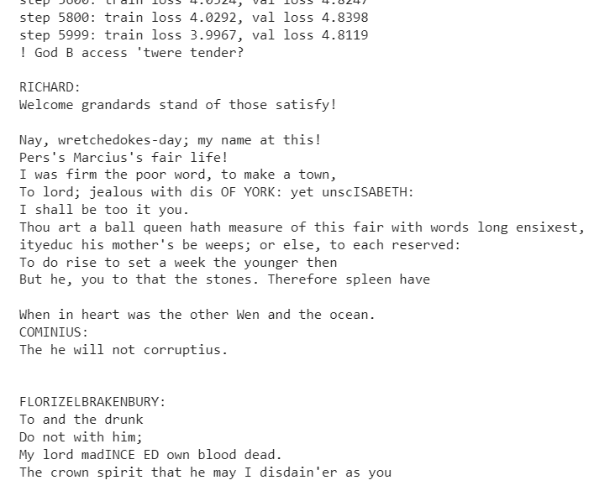
Attempts
3. Using OpenAI’s Tiktoken tokeniser
6.68 M parameters
6000 epochs
Loss : 4.811

Slide 12
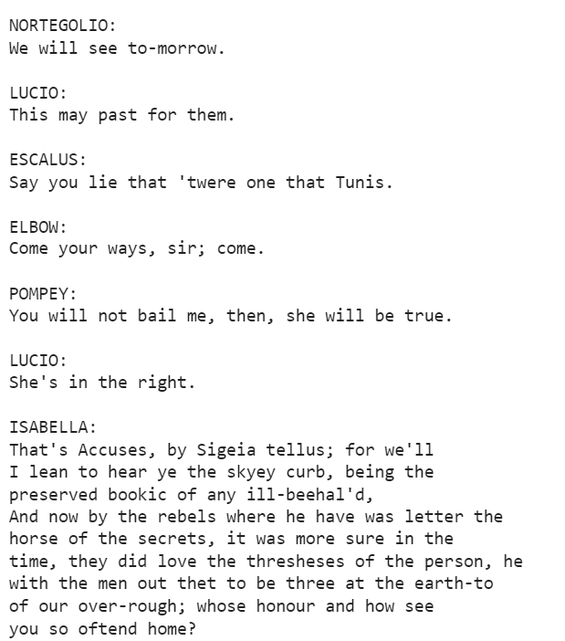
Attempts
4. Final model
( GPT + Res-Net + Init_wts + Prenorm + Dropout )
10.788 M parameters
17500 epochs
Loss: 0.0974

Slide 13
Loss Progress over Attempts

Slide 14
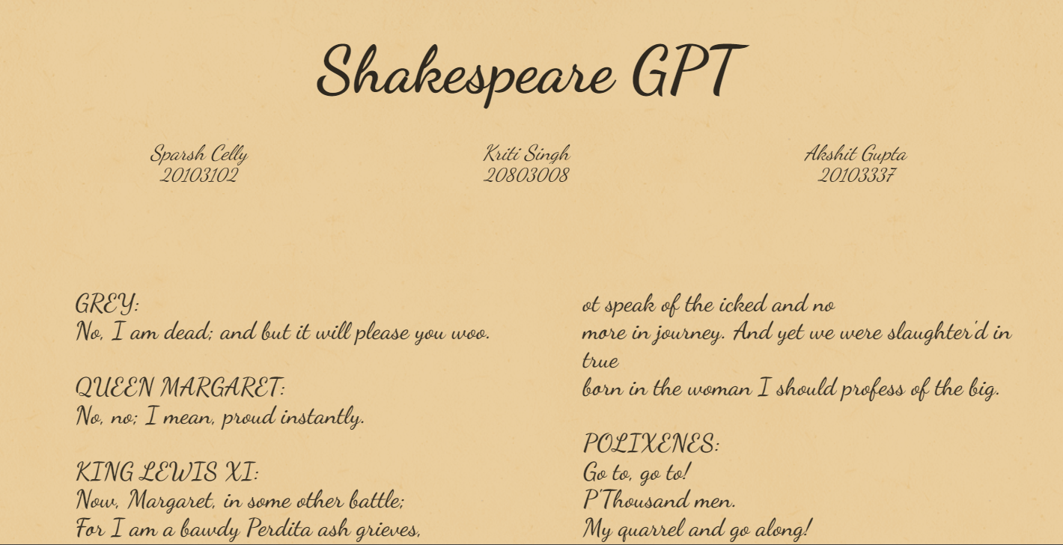
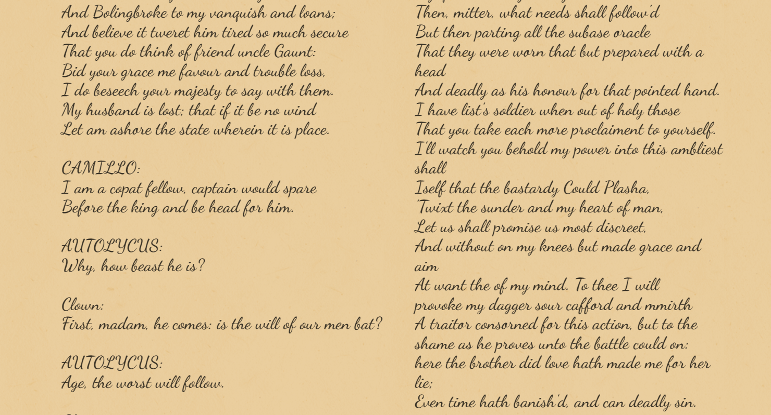
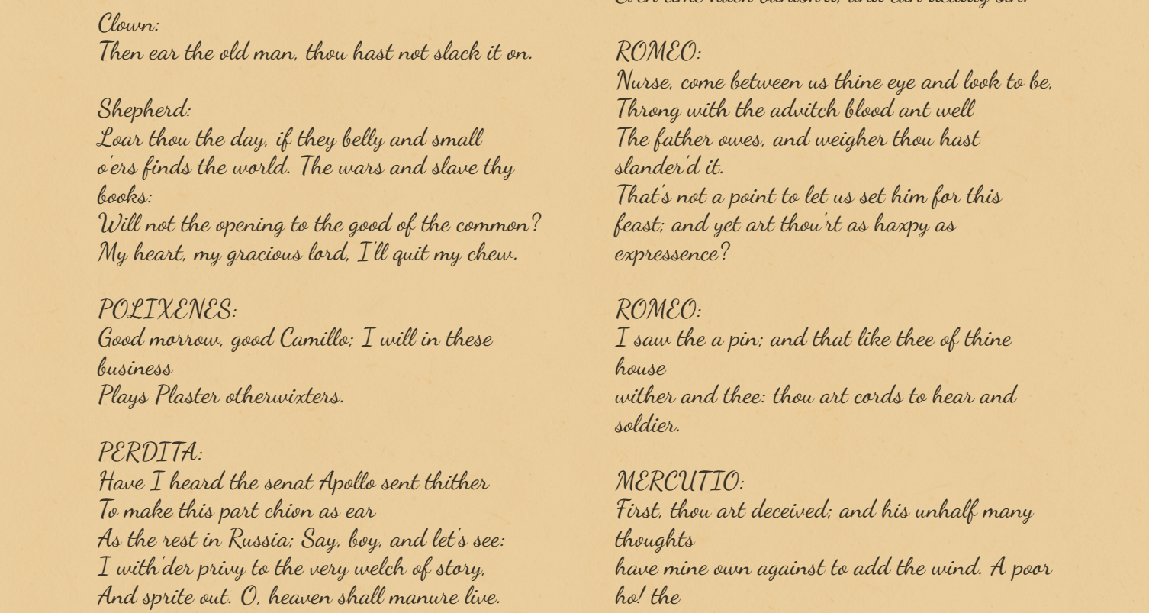
Future Prospects
Rhymes / Couplets / Scripts / Poems generation
Musical melodies generation
Recreate Old English / Languages
Implement Fine-tuning stage to answer prompts

